Slide 1
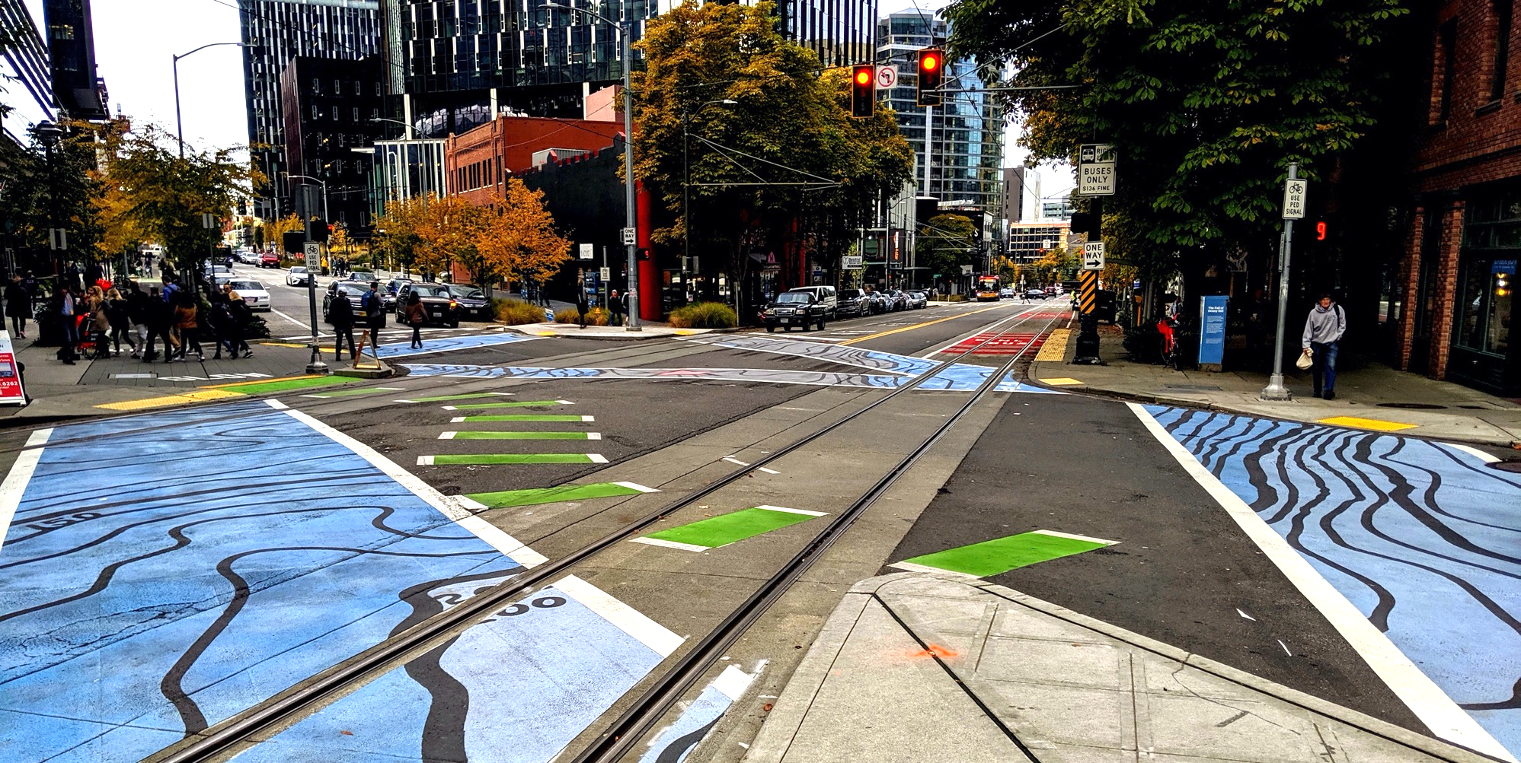
Policy & Operations Advisory Group
Policy & Operations Advisory Group
Transportation Operations and Policy & Planning Divisions

Slide 2
Meeting overview
Welcome
Modal Integration Policy Framework & future implementation
Discussion of POAG experience and process
POAG Next steps
Wrap-up and appreciation

Slide 3
Meeting format
We want to hear from you; we encourage you to chime in and participate
During presentations:
  We will screenshare slides
  Please stay on mute
  If you want to chime in or have quick questions answered as we go, please use the chat function (send to "all participants" or "all panelists") or raise hand function
Please say your name before you speak
If you are having technical difficulties, please use the chat or email ellie.smith@seattle.gov

Slide 4
Meeting objectives
Provide overview of the draft Modal Integration Policy Framework (SDOT)
Provide feedback on the policy framework for right-of-way allocation (POAG)
Discuss near-term and longer-term implementation strategies for modal integration
Learn from POAG experience
Discuss next steps

Slide 5
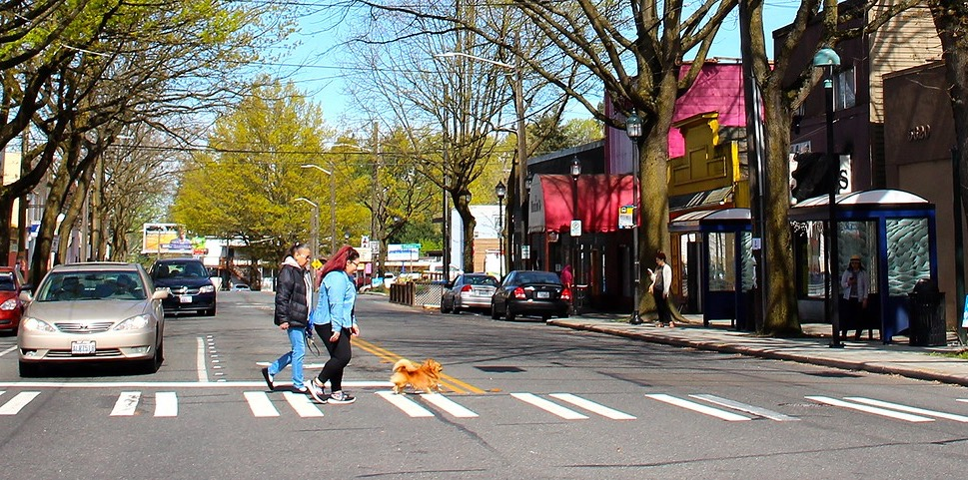
Modal Integration Policy Framework

Slide 6
Where we've been
Developed outcome statements
Mapped modal priority networks
Identified right-of-way deficiencies
Developed draft policy concepts to address deficiencies
Truth tested application of policies on deficient segments
Outlined next steps

Slide 7
Desired outcomes
The Modal Integration Policy Framework and its implementation are guided by three desired outcomes:
Determine how to accommodate modal networks where ROW space is deficient at the planning and concept design stages, rather than later within project design and delivery stages.
Optimize ROW allocation based on a policy framework that balances network function, land use development patterns, and local context.
Formalize a consistent and transparent approach for translating our plans and policies into project decisions and share our approach within our outreach efforts.

Slide 8

Policy concepts to address modal networks where ROW is deficient: Overview
In urban villages and centers, prioritize pedestrian movement
Between urban villages and centers, prioritize transit
In manufacturing/industrial centers, prioritize goods movement
At critical connections, prioritize bicycle network and legibility
all without compromising the safety of other users

Slide 9
Draft policies
Please refer to the Executive Summary for draft policy statements starting on page 5

Slide 10
Discussion
What elements of the DRAFT Modal Integration Policy are clear and work well?
What elements are confusing or need clarification?
Are there elements, narratives, or recommendations that are missing?
What are potential unintended consequences or SDOT blind spots?

Slide 11
Modal Integration:
Next Steps

Slide 12
Where we’re headed
Complete Modal Integration Policy Framework Report
Present analysis, describe policy framework, outline recommended actions to operationalize the policy framework
Near-term – internal tools and process improvement
  Complete policy framework, including complementary policy guidance
  Develop tools for planning and project-level conceptual design
Longer-term
Integrate 4 modal plans within a citywide integrated transportation plan

Slide 13
Complementary policies (near-term)
Complete interim policy framework to inform ROW allocation decisions
  Modal integration policies
  Pedestrian priority in urban centers and villages
  Bus lane policy
  Freight lane policy

Slide 14
Project development tools (near-term)
Develop modal constraints map and proposed solutions by applying policy framework
  In-house tool for project development purposes
Identify critical bicycle connections
  Project development tool to support delivery of bicycle network
Prepare curbside/flex zone change guidance
  Establish a consistent approach to support essential access functions
Develop outreach tools to support community conversations
  Create storytelling materials to connect Comprehensive and modal plan policies to individual projects

Slide 15
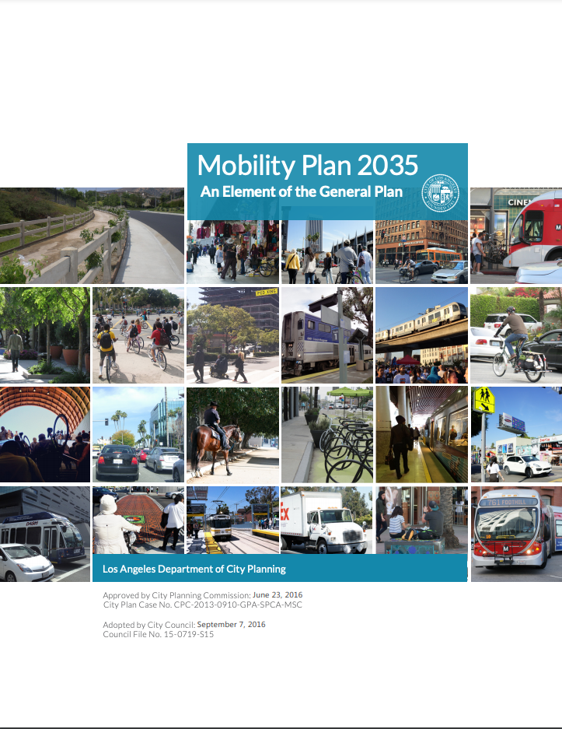
Citywide integrated transportation plan (longer-term)
Integrate 4 modal plans within a single plan
  Leverage 2024 Comprehensive Plan update
  Engage in community conversations around mobility and public space needs
  Combine 4 modal master plans and integrated policy framework
  Prepare for next transportation levy
    *This action is dependent on identifying resources

Slide 16
Discussion
Do our near-term and longer-term next steps help us achieve modal integration?
If not, what is missing?

Slide 17
Discussion of POAG Experience

Slide 18

Recap: original vision for POAG
Serve as a sounding board
Confer with respective constituent groups
Advise SDOT on integration of the various modal plans and related policy objectives
Learn about one another's interests, priorities, and concerns
Discuss current policies and how we analyze policies and evaluate tradeoffs
Contribute to development of draft policies for a balanced, multimodal transportation network

Slide 19
Discussion
What worked well for POAG meetings?
What could be improved?
What could the role of a group like this be in the future?

Slide 20
POAG: Next Steps

Slide 21
Next steps for you
Review Executive Summary of the Modal Integration Policy Framework Report
  Feedback welcome via email, via tracked changes/comments, or in follow-up 1x1 conversations
Evaluation of POAG process and format
  Survey via email soon – option to submit anonymously
Receive full Modal Integration Policy Framework Report

Slide 22

Thank you!
ellie.smith@seattle.gov | (206) 300-1690
https://www.seattle.gov/transportation/about-us/policy-and-operations-advisory-group

